Slide 1
Reduction of Entity-Relationship Diagram (ERD) to Relational Schema
Thangavelu S
Assistant Professor
CSE Department

Slide 2
SESSION -1

Slide 3
Reduction of ERD to Schema
E-R Model and Relational Database Model are abstract, logical representations of real-world enterprises.
Because both employ similar design principles, we can convert an E-R design into a Relational Design.

Slide 4
For Strong Entity Set With Only Simple Attributes
Entity sets which have a primary key are known as strong entity sets.
A strong entity set with only simple attributes will require only one table in relational model.
Attributes of the table will be the attributes of the entity set
The primary key of the table will be the key attribute of the entity set

Slide 5
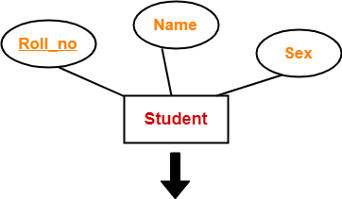
Is it a Strong Entity Set?
Yes
Contains Simple Attributes?
Yes
Any Complex Attributes (Composite, Multi-valued)?
No
Any Key Attribute?
Always Yes for Strong Entity Set
Key attribute Primary Key
Roll_no | Name | Sex
Roll_no | Name | Sex
Schema :
Student ( Roll_no , Name , Sex )

Slide 6
For Strong Entity Set With Composite Attributes
A strong entity set with any number of composite attributes will require only one table in relational model
While conversion, simple attributes of the composite attributes are taken into account and not the composite attribute itself.

Slide 7
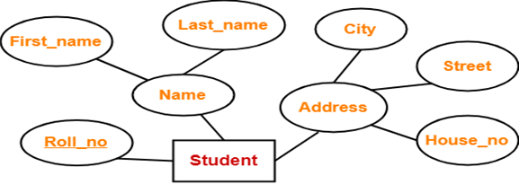
What are the Composite Attributes in this example?
Name and Address
What are the simple attributes in ‘Name’ ?
First_Name, Last_Name
What are the simple attributes in ‘Address’ ?
House_no, Street, City
By considering only simple attributes of the composite attributes in
schema design
Roll_no | First_name | Last_name | House_no | Street | City
Schema : Student ( Roll_no , First_name , Last_name , House_no , Street , City )

Slide 8
For Strong Entity Set With Multi-Valued Attributes
A strong entity set with multi-valued attribute will require two tables in relational model
One table will contain all the simple attributes with the primary key.
Other table will contain the primary key and the multi valued attribute.
Create a separate table for each multi-valued attribute.

Slide 9
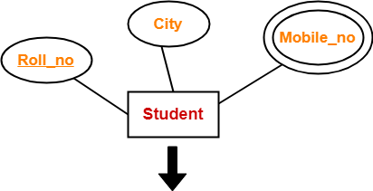
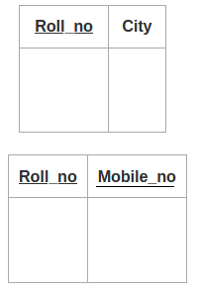
Is there a mutivalued attribute?
Yes – Mobile-no

Slide 10
For Strong Entity Set With Derived Attributes
A strong entity set with derived attribute just follow the previous rules of simple, composite and multi-valued attributes without a space for the derived attribute in the relational schema.
That is the derived attribute does not occupy any columns in the table.
No Need to create a column for the derived attribute
The value can be calculated at any point of time from the existing attribute. No need to store the calculate value into a database

Slide 11
For Strong Entity Set With Derived Attributes
Height
Aadhar_no
PERSON
Key attribute
DOB
Derived attribute
age
Aadhar_no | Height | DOB
Schema : Person ( Aadhar_no, Height, DOB)

Slide 12
Representation of Weak Entity Sets
The entity sets which do not have sufficient attributes to form a primary key are known as weak entity sets.
Weak entity is depend on strong entity to ensure the existence of weak entity.
The discriminator (or) partial key of a weak entity set is the set of attributes that distinguishes among all the entities of a weak entity set.
Weak entities are represented with double rectangular box in the ER Diagram and the identifying relationships are represented with double diamond.

Slide 13
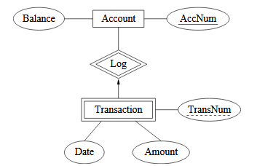

Contd..
A weak entity set becomes a table with all its attributes and also includes a column for the primary key of the identifying strong entity set.
Primary key
discriminator
Primary key + discriminator

Slide 14
Representation of Relationship Sets
Let R be a relationship set, let a₁, a₂, …, a_{m} be the set of attributes formed by the union of the primary keys of each of the entity sets participating in R.
Let the descriptive attributes (if any) of R be b₁, b₂,…, b_{n} .
The representation of relation for the relationship set R can have the attributes as
{a₁, a₂, …, a_{m} } U {b₁, b₂,…, b_{n} }

Slide 15
Representation of Relationship Sets (Contd..)
Selection of Primary key for the relation of relationship set
Binary many-to-many relationship
The union of the PK attributes from the (all) participating entity sets becomes the PK
Binary one-to-one relationship
The Primary key of either entity set can be chosen as the PK. The choice can be made arbitrarily
Binary many-to-one or one-to-many relationship
The Primary key of the entity set on the many side of the relationship set serves as the PK

Slide 16
Representation of Relationship Sets (Contd..)
Selection of Primary key for the relation of relationship set (Contd..)
N-ary relationship set without any arrows on its edges
The union of the PK attributes from the (all) participating entity sets becomes the PK
N-ary relationship set with an arrow on one of its edges
The Primary keys of the entity sets not on the arrow side of the relationship set serve as the PK for the schema

Slide 17
SESSION -2

Slide 18
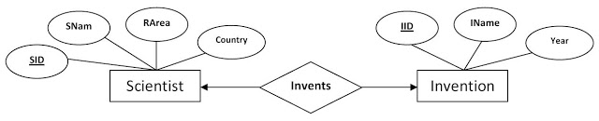
One-to-One Relationship with Simple Attributes
Entity sets and relationship sets
Name | Entity set / Relationship set | Type
Scientist | Entity set | Strong entity set
Invention | Entity set | Strong entity set
Invents | Relationship set | One-to-One relationship

Slide 19
One-to-One Relationship with Simple Attributes (Contd..)
Entity set Scientist
Attributes | Attribute Type | Description
SID | Simple and Primary key | Scientist ID
SName | Simple | Scientist Name
RArea | Simple | Research Area
Country | Simple | Country
Entity set Invention
Attributes | Attribute Type | Description
IID | Simple and Primary key | Invention ID
IName | Simple | Name of the invention
Year | Simple | Year of invention
Scientist (SID, SName, RArea, Country)
Invention (IID, IName, Year)

Slide 20
One-to-One Relationship with Simple Attributes (Contd..)
Relationship set
A relationship may be either converted into a separate table or not. That can be decided based on the type of the relationship.
Only many-to-many relationship needs to be created as a separate table.
Here, we are given a one-to-one relationship. That means, one entity (record/row) of Scientist can be related to at most one entity (record/row) of Invention entity.
To reduce / convert the relationship Invents into relational schema, we can include the primary key of either relation schemas into the other.

Slide 21
One-to-One Relationship with Simple Attributes (Contd..)
Relationship set
In our example, we can derive the final set of relation schemas as follows;
Include IID of Invention as the foreign key of Scientist
Scientist (SID, SName, RArea, Country, IID)
Invention (IID, IName, Year)
(OR)
Include SID of Scientist as the foreign key of Invention
Scientist (SID, SName, RArea, Country)
Invention (IID, IName, Year, SID)
Both are valid relational schemas.

Slide 22
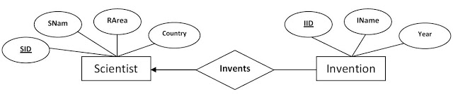
One-to-Many Relationship with Simple Attributes
Entity sets and relationship sets
Name | Entity set / Relationship set | Type
Scientist | Entity set | Strong entity set
Invention | Entity set | Strong entity set
Invents | Relationship set | One-to-Many relationship

Slide 23
One-to-Many Relationship with Simple Attributes
Entity set Scientist
Attributes | Attribute Type | Description
SID | Simple and Primary key | Scientist ID
SName | Simple | Scientist Name
RArea | Simple | Research Area
Country | Simple | Country
Entity set Invention
Attributes | Attribute Type | Description
IID | Simple and Primary key | Invention ID
IName | Simple | Name of the invention
Year | Simple | Year of invention
Scientist (SID, SName, RArea, Country)
Invention (IID, IName, Year)

Slide 24
One-to-Many Relationship with Simple Attributes (Contd..)
Relationship set
Here, we are given a one-to-many relationship. That means,
one entity (record/row) of Scientist can be related to many entities (records/rows) of Invention entity set (that is, a scientist may have invented one or more things) and,
one entity (record/row) of Invention is related to exactly one entity of Scientist entity set. (that is, one invention is uniquely done by a single scientist)

Slide 25
One-to-Many Relationship with Simple Attributes (Contd..)
Relationship set
To reduce the relationship Invents into relational schema, we need to include the primary key of one side relation schema (i.e., Scientist) into the many side relation (i.e., Invention) as foreign key.
For example, in our case we can derive the final set of relation schemas as follows;
Include SID of Scientist as the foreign key of Invention
Scientist (SID, SName, RArea, Country)
Invention (IID, IName, Year, SID)

Slide 26
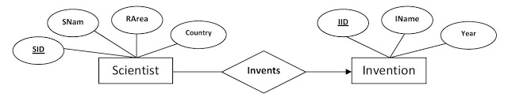
Many-to-One Relationship with Simple Attributes
Entity sets and relationship sets
Name | Entity set / Relationship set | Type
Scientist | Entity set | Strong entity set
Invention | Entity set | Strong entity set
Invents | Relationship set | Many-to-One relationship

Slide 27
Many-to-One Relationship with Simple Attributes
Entity set Scientist
Attributes | Attribute Type | Description
SID | Simple and Primary key | Scientist ID
SName | Simple | Scientist Name
RArea | Simple | Research Area
Country | Simple | Country
Entity set Invention
Attributes | Attribute Type | Description
IID | Simple and Primary key | Invention ID
IName | Simple | Name of the invention
Year | Simple | Year of invention
Scientist (SID, SName, RArea, Country)
Invention (IID, IName, Year)

Slide 28
Many-to-One Relationship with Simple Attributes (Contd..)
Relationship set
Here, we are given a many-to-one relationship. That means,
one entity (record/row) of Scientist is related to only one entity (records/rows) of Invention entity set (that is, a scientist is involved in only one invention) and,
one entity (record/row) of Invention is related to one or more entities (records/rows) of Scientist entity set. (that is, one or more scientists collectively invented one thing).

Slide 29
Many-to-One Relationship with Simple Attributes (Contd..)
Relationship set
To reduce the relationship Invents into relational schema, we need to include the primary key of one side relation schema (i.e., Invention) into the many side relation (i.e., Scientist) as foreign key.
For example, in our case we can derive the final set of relation schemas as follows;
Include IID of Invention as the foreign key of Scientist
Scientist (SID, SName, RArea, Country, IID)
Invention (IID, IName, Year)

Slide 30
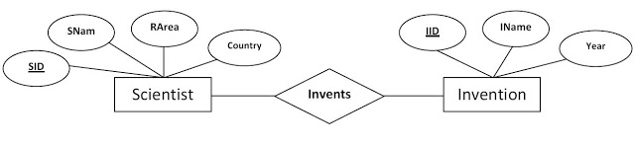
Many-to-Many Relationship with Simple Attributes
Entity sets and relationship sets
Name | Entity set / Relationship set | Type
Scientist | Entity set | Strong entity set
Invention | Entity set | Strong entity set
Invents | Relationship set | Many-to-Many relationship

Slide 31
Many-to-Many Relationship with Simple Attributes
Entity set Scientist
Attributes | Attribute Type | Description
SID | Simple and Primary key | Scientist ID
SName | Simple | Scientist Name
RArea | Simple | Research Area
Country | Simple | Country
Entity set Invention
Attributes | Attribute Type | Description
IID | Simple and Primary key | Invention ID
IName | Simple | Name of the invention
Year | Simple | Year of invention
Scientist (SID, SName, RArea, Country)
Invention (IID, IName, Year)

Slide 32
Many-to-Many Relationship with Simple Attributes (Contd..)
Relationship set
Here, we are given a many-to-many relationship. That means,
one entity (record/row) of Scientist is related to one or more entities (records/rows) of Invention entity set (that is, one scientist may have one or more inventions) and,
one entity (record/row) of Invention is related to one or more entities (records/rows) of Scientist entity set. (that is, one or more scientists may have collectively invented only one thing).

Slide 33
Many-to-Many Relationship with Simple Attributes (Contd..)
Relationship set
To reduce the relationship Invents into relational schema, we need to create a separate table for Invents, because Invents is a many-to-many relationship set.
Hence, create a table Invents with the primary keys of participating entity sets (both, Scientist and Invention) as the attributes.
Then we have,
Invents (SID, IID)
Here, SID and IID are both foreign keys and
collectively forms the primary key of Invents table.

Slide 34
Many-to-Many Relationship with Simple Attributes (Contd..)
Final relation schemas of the given ER diagram are as follows;
Scientist (SID, SName, RArea, Country, IID)
Invention (IID, IName, Year)
Invents (SID, IID)

Slide 35
Thank You

